Slide 1
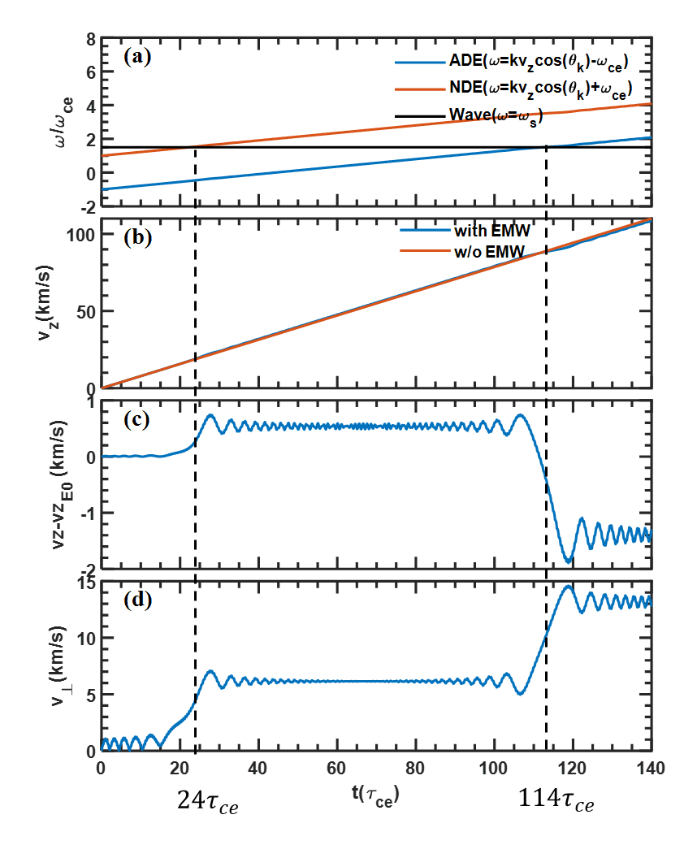


$$24τ_{ce}$$
$$114τ_{ce}$$

Slide 3
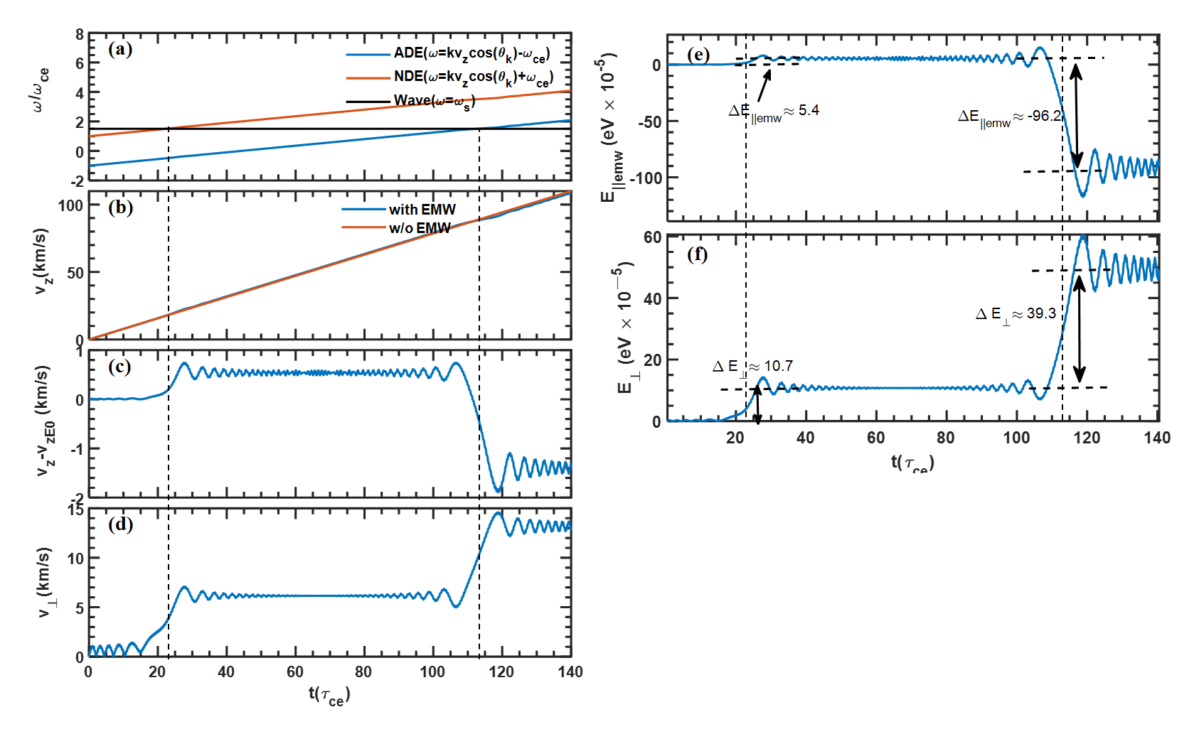

Slide 4
